Slide 1
函数即服务 – Function as a Service
日 期：2024.11.14
汇报人：庄琪钰

Slide 2
Serverless 概述
传统 IT
云
云原生 Serverless
IaaS
CaaS
PaaS
FaaS
SaaS
More control
Less control
应用逻辑
应用逻辑
应用逻辑
应用逻辑
应用逻辑
应用逻辑
函数
函数
函数
函数
函数
函数
容器
容器
容器
容器
容器
容器
操作系统
操作系统
操作系统
操作系统
操作系统
操作系统
服务器
服务器
服务器
服务器
服务器
服务器
数据中心
数据中心
数据中心
数据中心
数据中心
数据中心
物理机租赁
AWS EC2,
Azure Virtual Machines,
Google Compute Engine
Azure Kubernetes Service,
AWS ECS
AWS Elastic Beanstalk,
Google App Engine
Azure Function,
AWS Lambda,
Google Cloud Functions
Office 365,
Dropbox,
Oracle SaaS,
Slack
Notes:
资源整合和分配规则的演变
CaaS 将容器部署到云上，K8S 自动扩展
对负载变化的响应时间不一样：
从 几天 到 几毫秒
资源分配的粒度也不一样：
OpenFaas 可以做到以1MB 单位扩展内存
IaaS,CaaS,PaaS 大多以 256M 和 256M per step 或更高

Slide 3
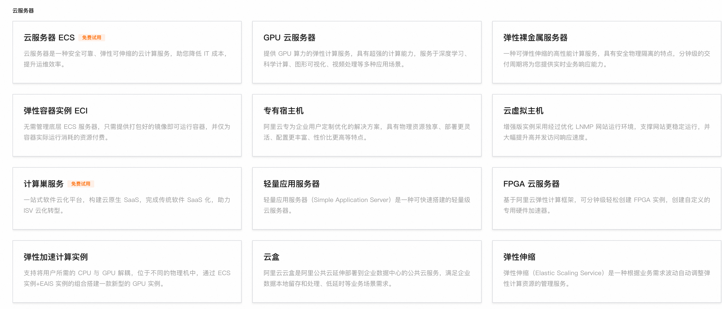
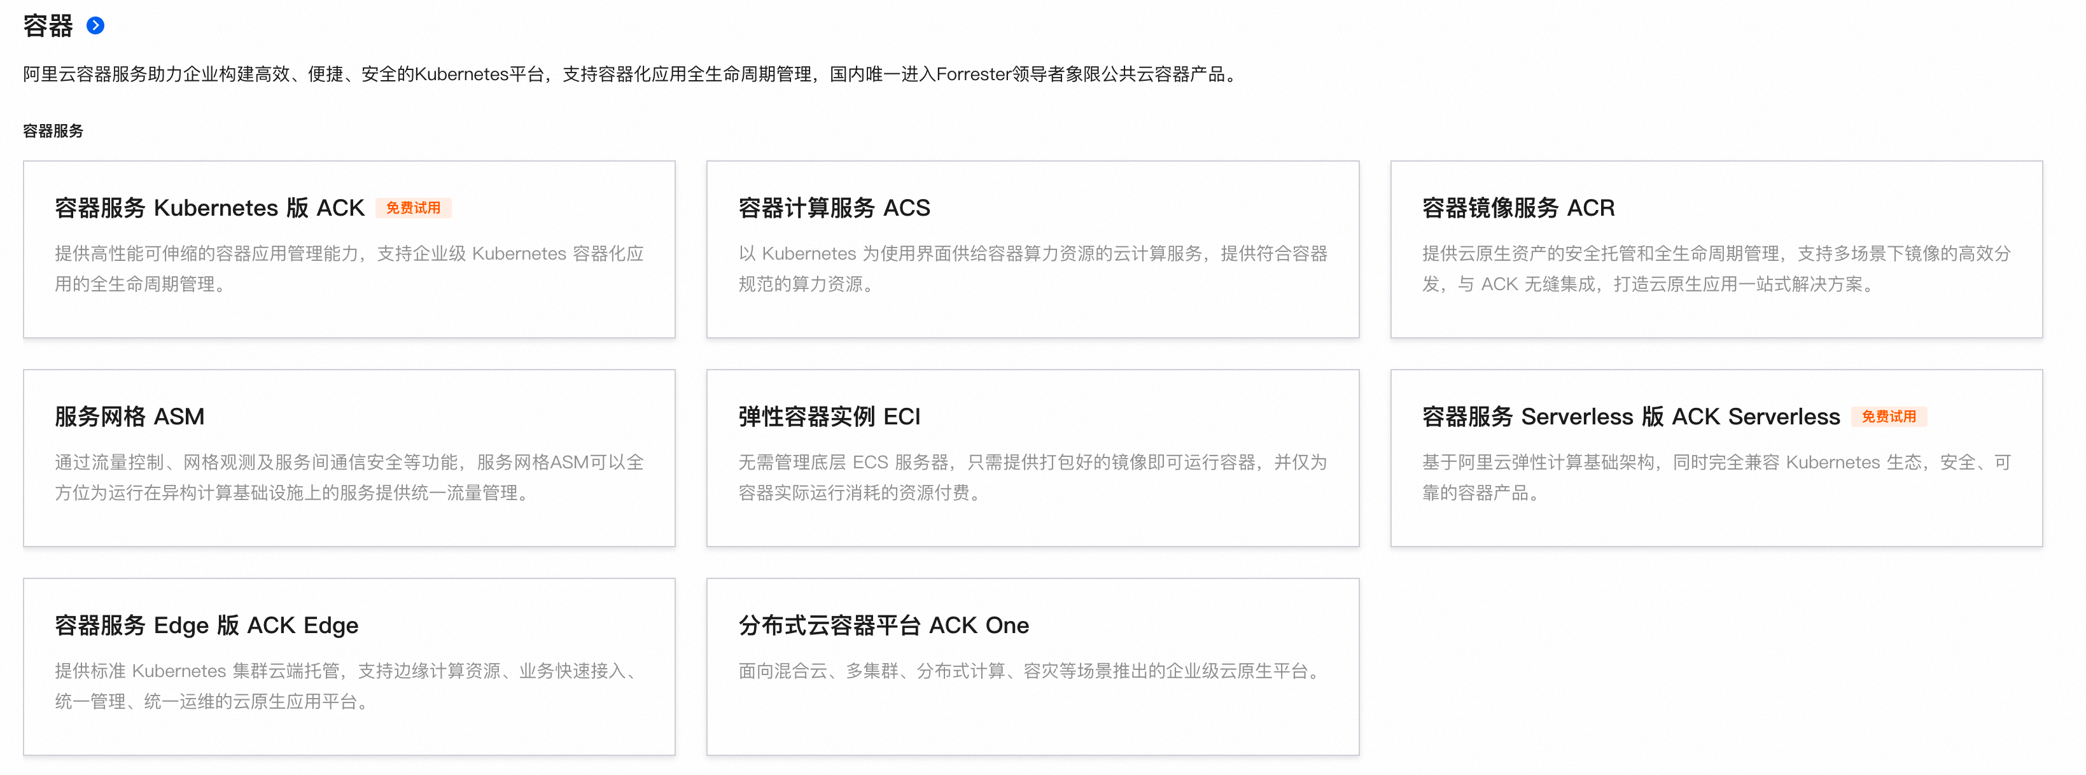
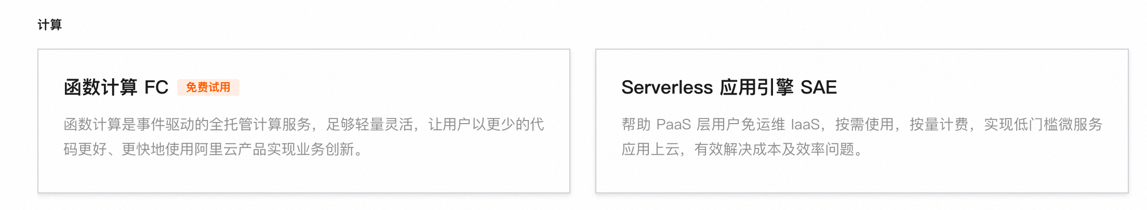
Serverless 概述
Notes:
资源整合和分配规则的演变
CaaS 将容器部署到云上，K8S 自动扩展
对负载变化的响应时间不一样：
从 几天 到 几毫秒
资源分配的粒度也不一样：
OpenFaas 可以做到以1MB 单位扩展内存
IaaS,CaaS,PaaS 大多以 256M 和 256M per step 或更高

Slide 4








Traditional vs FaaS
开发函数并在 FaaS 平台中注册
购物软件
应用开发人员
开发
应用开发人员
部署
下单函数
服务器
API 网关
身份验证函数
供应/管理
虚拟机/物理机
用户
注册函数
Databases
供应/管理
Database
Traditional
FaaS
FaaS 平台/供应商
Notes:
函数和函数之间

Slide 5
围绕 FaaS 的研究工作
冷启动：
﻿CodeCrunch, ﻿ RainbowCake, FaaSMem - ASPLOS’24 [压缩、分层]
﻿Erlang - EuroSys’24, JIAGU - ATC’24, XFaaS - SOSP’23, ... [调度 function 执行]
有状态函数即服务 (Stateful Function as a Service, SFaaS)：
﻿RMMAP - EuroSys’24, FaaSFlow - ASPLOS’22, Nightcore - ASPLOS’21 [State transfer]
Beldi - OSDI’20, Cloudburst - VLDB’20, Boki - SOSP’21, ... [SFaaS framework]
CausalMesh - VLDB’25, FaasTCC - Middleware’21 [缓存因果一致性]
其他：
Atlas - EuroSys’24 [混合云]
Pronghorn - ASPLOS’24, ﻿Catalyzer - ASPLOS’20 [JIT 编译优化]
﻿Everywhere All at Once: Co-Location Attacks on Public Cloud FaaS - ASPLOS’24 [安全]
μ2sls – POPL’23 [基于霍尔逻辑的形式化证明]
...

Slide 6
围绕 FaaS 的研究工作
冷启动：
﻿CodeCrunch, ﻿ RainbowCake, FaaSMem - ASPLOS’24 [压缩、分层]
﻿Erlang - EuroSys’24, JIAGU - ATC’24, XFaaS - SOSP’23, ... [调度 function 执行]
有状态函数即服务 (Stateful Function as a Service, SFaaS)：
﻿RMMAP - EuroSys’24, FaaSFlow - ASPLOS’22, Nightcore - ASPLOS’21 [State transfer]
Beldi - OSDI’20,, Cloudburst - VLDB’20, Boki - SOSP’21, ... [SFaaS framework]
CausalMesh - VLDB’25, FaasTCC - Middleware’21 [缓存因果一致性]
其他：
Atlas - EuroSys’24 [混合云]
Pronghorn - ASPLOS’24, ﻿Catalyzer - ASPLOS’20 [JIT 编译优化]
﻿Everywhere All at Once: Co-Location Attacks on Public Cloud FaaS - ASPLOS’24 [安全]
μ2sls – POPL’23 [基于霍尔逻辑的形式化证明]
...

Slide 7
Fault-tolerant and transactional stateful serverless workflows
Notes:
很多 serverless function 底层接入的是 S3 这种

Slide 8
Serverless 故障恢复
Send Request
Start
N = Read(“attendees”)
Write(“attendees”, N+1)
End
Client
Cloud

Slide 9
Serverless 故障恢复
Send Request
Start
N = Read(“attendees”)
Receive Error/Timeout
Write(“attendees”, N+1)
End
Client
Cloud

Slide 10
Serverless 故障恢复
Send Request
Start
N = Read(“attendees”)
Receive Error/Timeout
Write(“attendees”, N+1)
Retry?
End
Client
Cloud

Slide 11
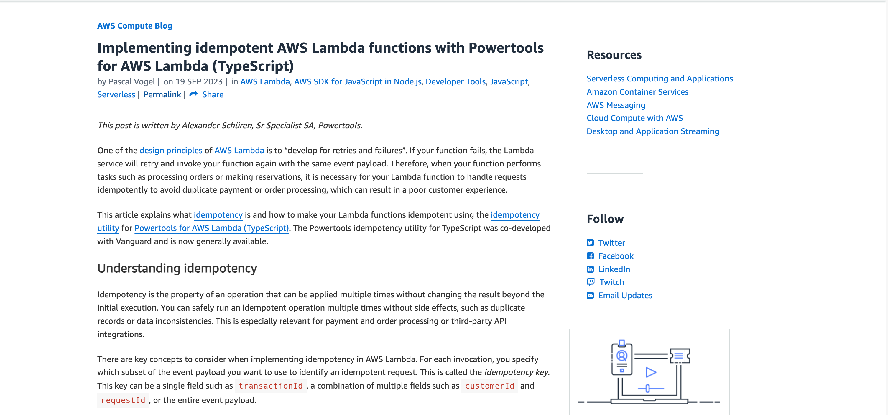
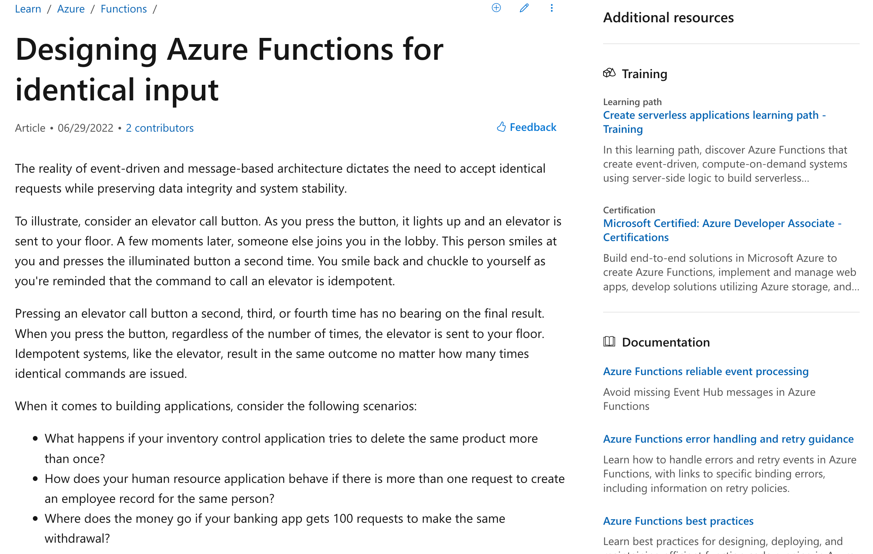
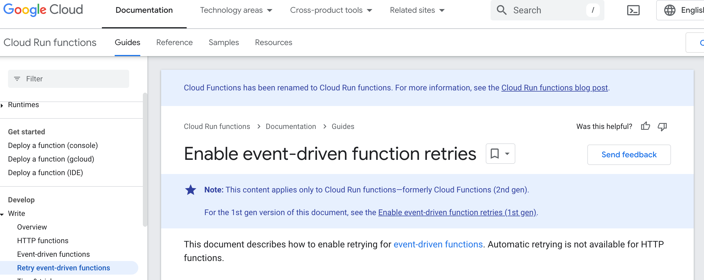
Write Idempotent Functions!

Slide 12
SFaaS 的要求
“一次执行”语义（exactly-once semantics）
即使函数执行过程中实例中止了（crash），其一次或多次重启后的状态等价于一次完整执行的状态。
数据隔离性（data sovereign）
函数的开发和管理具有独立性。不同的部门管理各自的数据库，并且开发各自的函数，但一个应用工作流中调用由不同的部门开发的函数。
重用性（reusability）
允许在多个工作流中同时使用相同的函数。这需要每个函数拥有不同的表或数据库来分别维护每个应用程序的状态，还应该支持跨应用程序状态。
支持跨函数事务（workflow transaction）
提供事务的功能，允许应用程序将工作流的任何子图划分为事务，保证这些子图的 ACID 特性。
Notes:
目标和断点续作有点像，但是他需要保证没有事务语义的函数

Slide 13
Beldi 系统架构
Start
N = Read(“attendees”)
Write(“attendees”, N+1)
End
Worker
Beldi Runtime
Storage

Slide 14
Beldi 系统架构
Start
N = Read(“attendees”)
Database API
Write(“attendees”, N+1)
End
Worker
Beldi Runtime
Storage
Notes:
database api 用于函数对数据库的调用

Slide 15
Beldi 系统架构
Start
N = Read(“attendees”)
Database API
Write(“attendees”, N+1)
Invocation API
End
Worker
Beldi Runtime
Storage
Notes:
invocation api 用于调用函数实例

Slide 16
Beldi 系统架构
Start
N = Read(“attendees”)
Database API
Write(“attendees”, N+1)
Invocation API
End
Transaction API
Worker
Beldi Runtime
Storage
Notes:
Transaction api 用于在函数中引入事务

Slide 17
Beldi 系统架构
Start
Instance Id | Done
N = Read(“attendees”)
Database API
Write(“attendees”, N+1)
Invocation API
End
Transaction API
Worker
Beldi Runtime
Storage
Notes:
函数实例和以及其状态

Slide 18
Beldi 系统架构
Start
Instance Id | Done
N = Read(“attendees”)
Database API
Key | Value
attendees | 10
Write(“attendees”, N+1)
Invocation API
End
Transaction API
Worker
Beldi Runtime
Storage
Notes:
数据库中的表

Slide 19
Beldi 系统架构
Start
Instance Id | Done
N = Read(“attendees”)
Database API
Key | Value
attendees | 10
Write(“attendees”, N+1)
Invocation API
End
Operation | Value
Transaction API
Worker
Beldi Runtime
Storage
Notes:
事务操作记录表

Slide 20
Beldi 系统架构
Start
Instance Id | Done
d78590e | False → True
N = Read(“attendees”)
Key | Value
attendees | 10
Write(“attendees”, N+1)
End
Operation | Value
Worker
Beldi Runtime
Storage
Notes:
在这个例子中，该函数

Slide 21

Beldi 系统架构
Start
Instance Id | Done
d78590e | False
Progress Lambda
N = Read(“attendees”)
Key | Value
attendees | 10
Write(“attendees”, N+1)
End
Operation | Value
Worker
Beldi Runtime
Storage

Slide 22
Beldi 系统架构
Start
Instance Id | Done
d78590e | False
Progress Lambda
N = Read(“attendees”)
Database API
Key | Value
attendees | 10
Write(“attendees”, N+1)
End
Operation | Value
Worker
Beldi Runtime
Storage

Slide 23
Beldi 系统架构
Start
Instance Id | Done
d78590e | False
Progress Lambda
N = Read(“attendees”)
Database API
Key | Value
attendees | 10
Write(“attendees”, N+1)
End
Operation | Value
d78590e-1 | 10
Worker
Beldi Runtime
Storage
Notes:
如果函数在 read 后发生故障，那么可以从 read log 中

Slide 24
Beldi 系统架构
Start
Instance Id | Done
d78590e | False
Progress Lambda
N = Read(“attendees”)
Database API
Key | Value
attendees | 10
Write(“attendees”, N+1)
End
Operation | Value
d78590e-1 | 10
Worker
Beldi Runtime
Storage

Slide 25
Beldi 系统架构
Start
Key | Value
attendees | 10
1
N = Read(“attendees”)
Database API
Operation | Value
d78590e-1 | 10
Write(“attendees”, N+1)
End
Worker
Beldi Runtime
Storage

Slide 26
Beldi 系统架构
Start
Key | Value
attendees | 10
1
N = Read(“attendees”)
Database API
Operation | Value
d78590e-1 | 10
d78590e-2
Write(“attendees”, N+1)
2
End
Worker
Beldi Runtime
Storage

Slide 27
Beldi 系统架构
Start
Key | Value
attendees | 11
1
N = Read(“attendees”)
Database API
Operation | Value
d78590e-1 | 10
d78590e-2
Write(“attendees”, N+1)
2
End
Worker
Beldi Runtime
Storage
Notes:
1 和 2 必须同时做。Beldi采用的方法就是在 write log 中加入 data

Slide 28
Beldi 系统架构
Start
Instance Id | Done
d78590e | False
Progress Lambda
N = Read(“attendees”)
Database API
Key | Value | Recent Writes
attendees | 10
Write(“attendees”, N+1)
End
Operation | Value
d78590e-1 | 10
Worker
Beldi Runtime
Storage

Slide 29
Beldi 系统架构
Start
Instance Id | Done
d78590e | False
Progress Lambda
N = Read(“attendees”)
Database API
Key | Value | Recent Writes
attendees | 11 | d78590e-2
Write(“attendees”, N+1)
Garbage Collector
End
Operation | Value
d78590e-1 | 10
Worker
Beldi Runtime
Storage

Slide 30
Linked Distributed Atomic Affinity Logging
Primary Key
HEAD
Key
Value
Lock Owner
Recent Writes
Next Row
Row Id
Key
Value
Lock Owner
Recent Writes
Next Row
Row Id
Key
Value
Recent Writes
Next Row
…
HEAD
attendees
10
[d78590e-1, …, d78590e-1000]
f9cec2e
Row Id
Key
Value
Recent Writes
Next Row
…
f9cec2e
attendees
11
d78590e-1001
Notes:
在一些 NoSQL 中，没有事务的概念，并且原子更新是有大小限制的。所有 Beldi 设计了一个数据机构去组织 Operation Log，原子性亲和的日志

Slide 31
Traverse Approach on Linked DAAL
Primary Key
HEAD
Key
Value
…
Recent Writes
Next Row
Row Id
Key
Value
…
Recent Writes
Next Row
Row Id
Key
Value
…
Recent Writes
Next Row
Notes:
一行一行的搜索

Slide 32
Traverse Approach on Linked DAAL
Primary Key
HEAD
Key
Value
…
Recent Writes
Next Row
Row Id
Key
Value
…
Recent Writes
Next Row
Row Id
Key
Value
…
Recent Writes
Next Row
Notes:
一行一行的搜索

Slide 33
Traverse Approach on Linked DAAL
Primary Key
HEAD
Key
Value
…
Recent Writes
Next Row
Row Id
Key
Value
…
Recent Writes
Next Row
Row Id
Key
Value
…
Recent Writes
Next Row
Notes:
一行一行的搜索

Slide 34
Traverse Approach on Linked DAAL
Primary Key
HEAD
Key
Value
…
Recent Writes
Next Row
Row Id
Key
Value
…
Recent Writes
Next Row
Row Id
Key
Value
…
Recent Writes
Next Row
Notes:
一行一行的搜索

Slide 35
Traverse Approach on Linked DAAL
Primary Key
HEAD
Key
Value
…
Recent Writes
Next Row
Row Id
Key
Value
…
Recent Writes
Next Row
Row Id
Key
Value
…
Recent Writes
Next Row
Notes:
一行一行的搜索

Slide 36
Traverse Approach on Linked DAAL
Primary Key
HEAD
Key
Value
…
Recent Writes
Next Row
Row Id
Key
Value
…
Recent Writes
Next Row
Row Id
Key
Value
…
Recent Writes
Next Row
Optimize by Scan and Projection
Notes:
一行一行的搜索

Slide 37
Traverse Approach on Linked DAAL
Primary Key
HEAD
Key
Value
…
Next Row
HEAD
Next Row
256 Bits
Row Id
Key
Value
…
Next Row
Row Id
Next Row
Row Id
Key
Value
…
Next Row
Row Id
Next Row
Notes:
一行一行的搜索

Slide 38
Exactly-once Semantics
Function 1
Function 2
Call Function 2
Log in Intent Table
invoke log
intent table
Operation | Callee
d78590e-1 | b97bbe0
Instance Id | Done
b97bbe0 | False

Slide 39
Exactly-once Semantics
Function 1
Function 2
Call Function 2
Log in Intent Table
Make some writes
Operation | Callee
d78590e-1 | b97bbe0
Instance Id | Done
b97bbe0 | False

Slide 40
Exactly-once Semantics
Function 1
Function 2
Call Function 2
Log in Intent Table
Make some writes
Make as Done
Operation | Callee
d78590e-1 | b97bbe0
Instance Id | Done
b97bbe0 | True

Slide 41
Exactly-once Semantics
Function 1
Function 2
Call Function 2
Log in Intent Table
Make some writes
Make as Done
Operation | Callee
d78590e-1 | b97bbe0
Instance Id | Done
b97bbe0 | True

Slide 42
Exactly-once Semantics
Function 1
Function 2
Call Function 2
Log in Intent Table
Make some writes
Retry
Make as Done
Operation | Callee
d78590e-1 | b97bbe0
Instance Id | Done
b97bbe0 | True

Slide 43
Exactly-once Semantics
Function 1
Function 2
Call Function 2
Log in Intent Table
Operation | Callee
d78590e-1 | b97bbe0
Instance Id | Done
b97bbe0 | True

Slide 44
Exactly-once Semantics
Function 1
Function 2
Call Function 2
Log in Intent Table
Make some writes
Receive Response
Make as Done
Operation | Callee
d78590e-1 | b97bbe0
Instance Id | Done
b97bbe0 | True

Slide 45
Potential Error, Back to Failure Point
Function 1
Function 2
Call Function 2
Garbage Collection Lambda
Operation | Callee
d78590e-1 | b97bbe0
Instance Id | Done
b97bbe0 | True

Slide 46
Potential Error
Function 1
Function 2
Call Function 2
Log in Intent Table
Make some writes
Operation | Callee
d78590e-1 | b97bbe0
Instance Id | Done
b97bbe0 | False

Slide 47
Potential Error
Function 1
Function 2
Call Function 2
Log in Progress Table
Make some writes
Violate Exactly-once Semantics
Operation | Callee
d78590e-1 | b97bbe0
Instance Id | Done
b97bbe0 | False

Slide 48
Exactly-once Semantics
Function 1
Function 2
Call Function 2
invoke log
Operation | Callee | Result
d78590e-1 | b97bbe0

Slide 49
Exactly-once Semantics
Function 1
Function 2
Call Function 2
Log in Intent Table
Make some writes
invoke log
Operation | Callee | Result
d78590e-1 | b97bbe0
Instance Id | Done
b97bbe0 | True

Slide 50
Exactly-once Semantics
Function 1
Function 2
Call Function 2
Log in Intent Table
Make some writes
Callback
Mark as Done
Operation | Callee | Result
d78590e-1 | b97bbe0 | result

Slide 51
Beldi 中的事务
并发控制算法和提交逻辑：2PL + wait-die 死锁避免 + 2PC
事务中不能有异步函数调用 （asyncInvoke）
在调用 begin_txn() 时，创建一个 top-level 事务上下文，该上下文会被 workflow 中的下游函数继承
当一个没有事务要求（non-transactional）的函数在一个有事务要求（transactional）的函数中调用时，non-transactional function 也需要加锁
Notes:
上面的精确一次语义，如果用事务包裹，就不需要有那些特殊的设计了。
感觉可以用关系型数据库管理NoSQL中需要限制并发的操作，并且支持在一个事务中设置多种隔离级别。

Slide 52
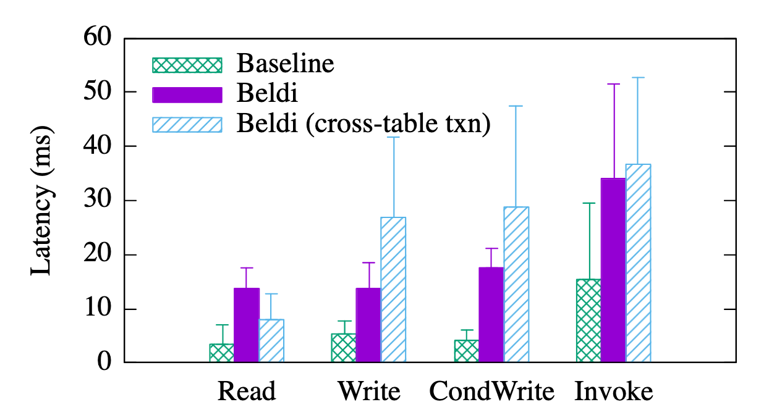
实验结果
在 Linked DAAL 中有 20 行，基础函数调用的时延上升了 2 – 4 倍

Slide 53
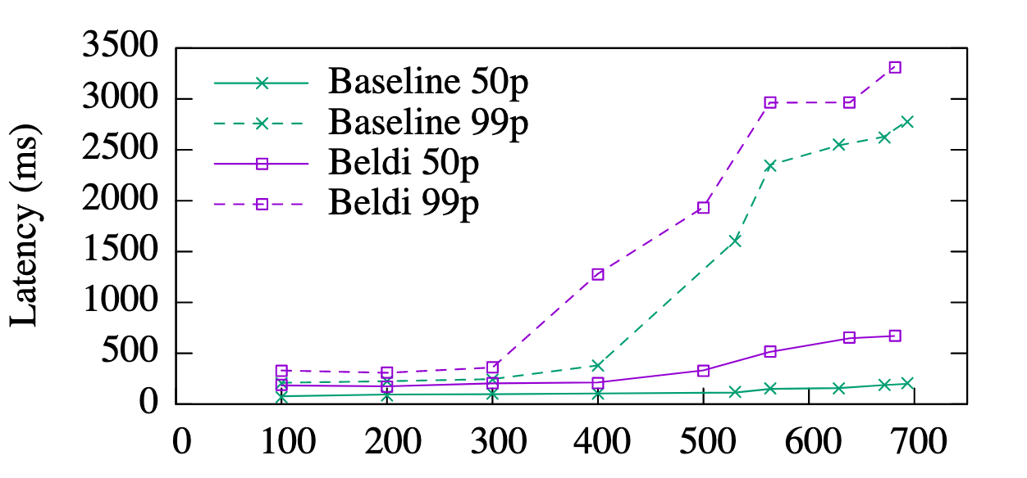
实验结果
< 400 req/s: 时延是原先的2倍
700 req/s: 是 baseline 的 3.3倍

Slide 54
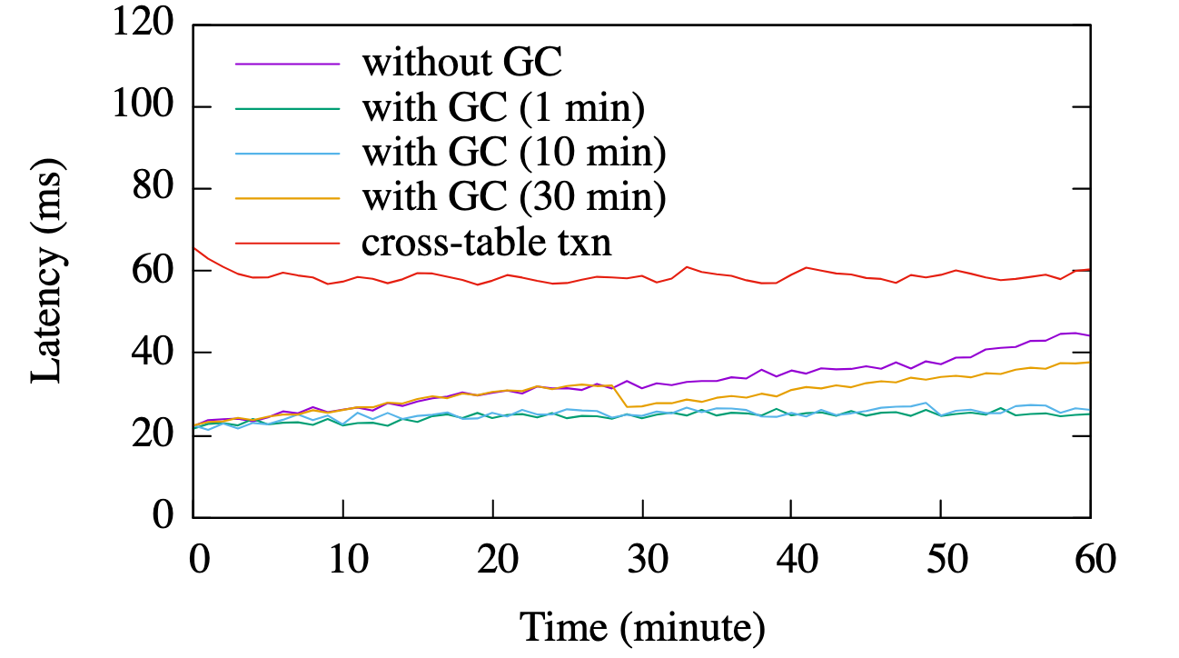
实验结果
时延轻微地受 GC 频率影响

Slide 55
Thank you!

Slide 56
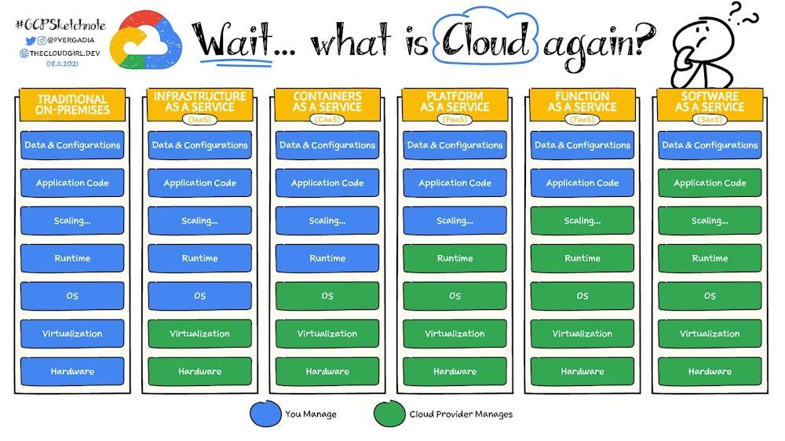
Serverless 概述
Notes:
资源整合和分配规则的演变
XXX as a Service 的优势：
功能解耦，方便横向和纵向扩

Slide 57
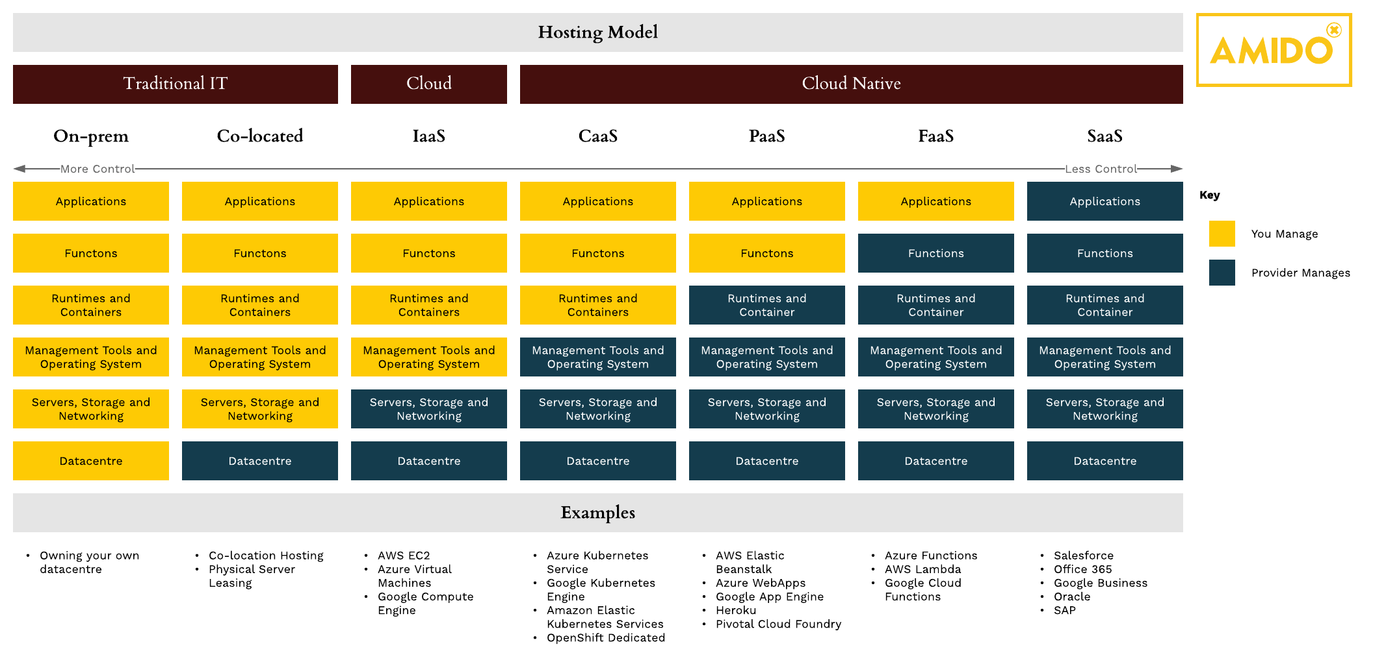
Serverless 概述
身份验证函数
Infrastructure as a Service (IaaS)
Platform as a Service (PaaS)
Function as a Service (FaaS)
资源分配粒度：
响应时间：
Notes:
资源整合和分配规则的演变
XXX as a Service 的优势：
功能解耦，方便横向和纵向扩

